Slide 1
8. Estimation

Slide 2
Content
1. Introduction
2. Parameter estimation
3. Properties of parameter estimators
4. Interval Estimation

Slide 3
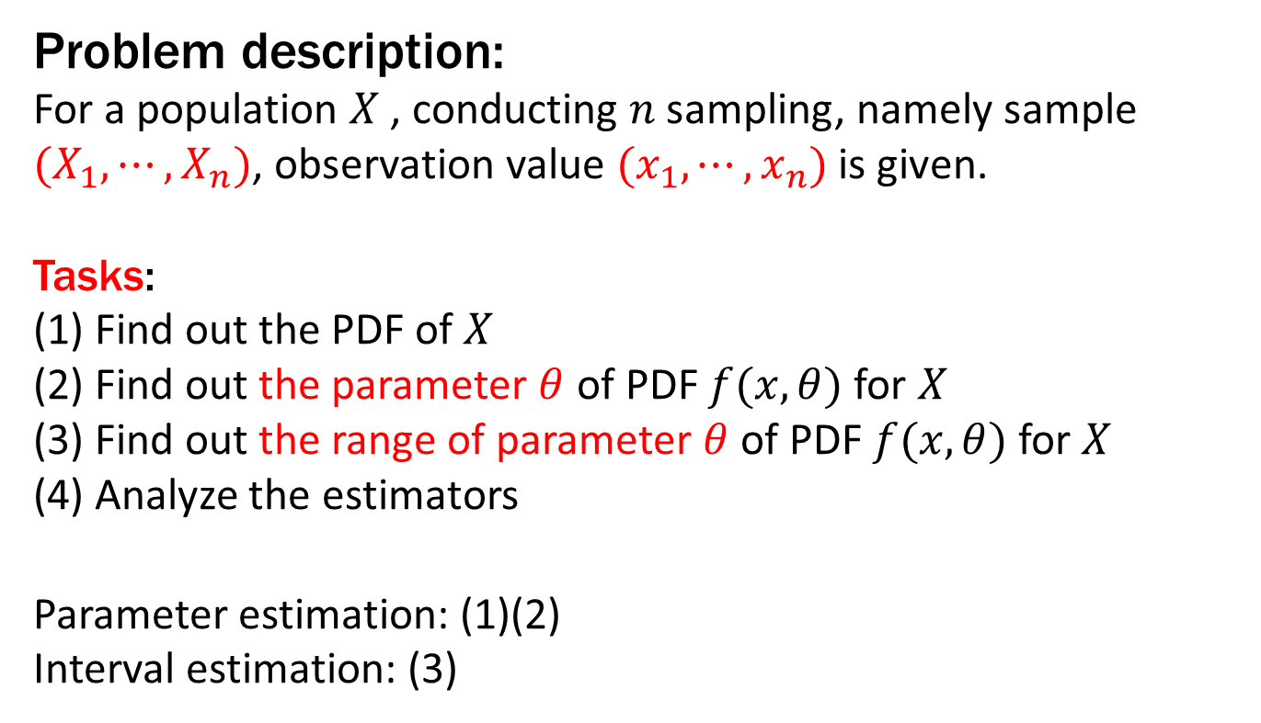
1 Introduction
Problem description:
For a population $X$, conducting $n$sampling, namely sample ${(X}_{1},⋯,X_{n})$, observation value ${(x}_{1},⋯,x_{n})$ is given.
Tasks:
(1) Find out the PDF of $X$
(2) Find out the parameter $θ$ of PDF $f(x,θ)$ for $X$
(3) Find out the range of parameter $θ$ of PDF $f(x,θ)$ for $X$
(4) Analyze the estimators
Parameter estimation: (1)(2)
Interval estimation: (3)

Slide 4
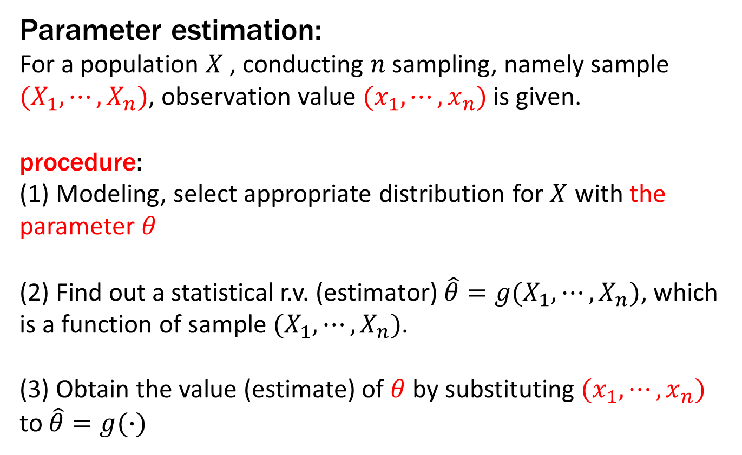
1 Introduction
Parameter estimation:
For a population $X$, conducting $n$sampling, namely sample ${(X}_{1},⋯,X_{n})$, observation value ${(x}_{1},⋯,x_{n})$ is given.
procedure:
(1) Modeling, select appropriate distribution for $X$ with the parameter $θ$
(2) Find out a statistical r.v. (estimator) $\hat{θ}=g(X_{1},⋯,X_{n})$, which is a function of sample $(X_{1},⋯,X_{n})$.
(3) Obtain the value (estimate) of $θ$ by substituting ${(x}_{1},⋯,x_{n})$ to $\hat{θ}=g(∙)$

Slide 5
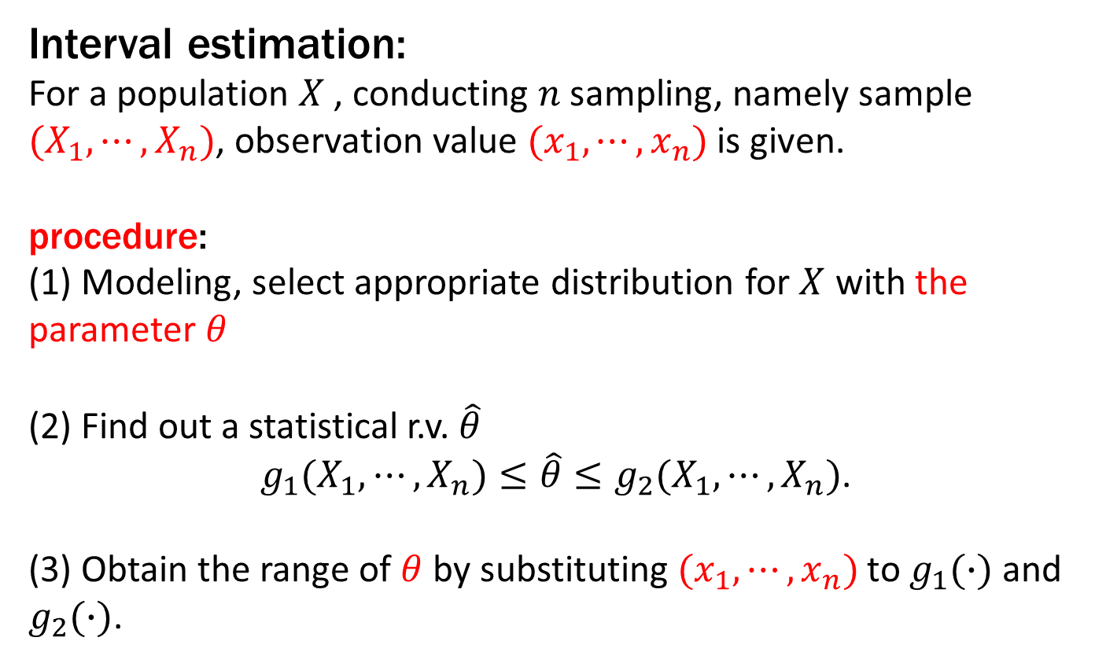
1 Introduction
Interval estimation:
For a population $X$, conducting $n$sampling, namely sample ${(X}_{1},⋯,X_{n})$, observation value ${(x}_{1},⋯,x_{n})$ is given.
procedure:
(1) Modeling, select appropriate distribution for $X$ with the parameter $θ$
(2) Find out a statistical r.v. $\hat{θ}$
$g_{1}(X_{1},⋯,X_{n})≤\hat{θ}≤g_{2}(X_{1},⋯,X_{n})$.
(3) Obtain the range of $θ$ by substituting ${(x}_{1},⋯,x_{n})$ to $g_{1}(∙)$ and $g_{2}(∙)$.

Slide 6
2 Parameter estimation
Two methods:
1. Moment estimation
using moment theorem;
2. Maximum likelihood estimation
using differential equation;

Slide 7
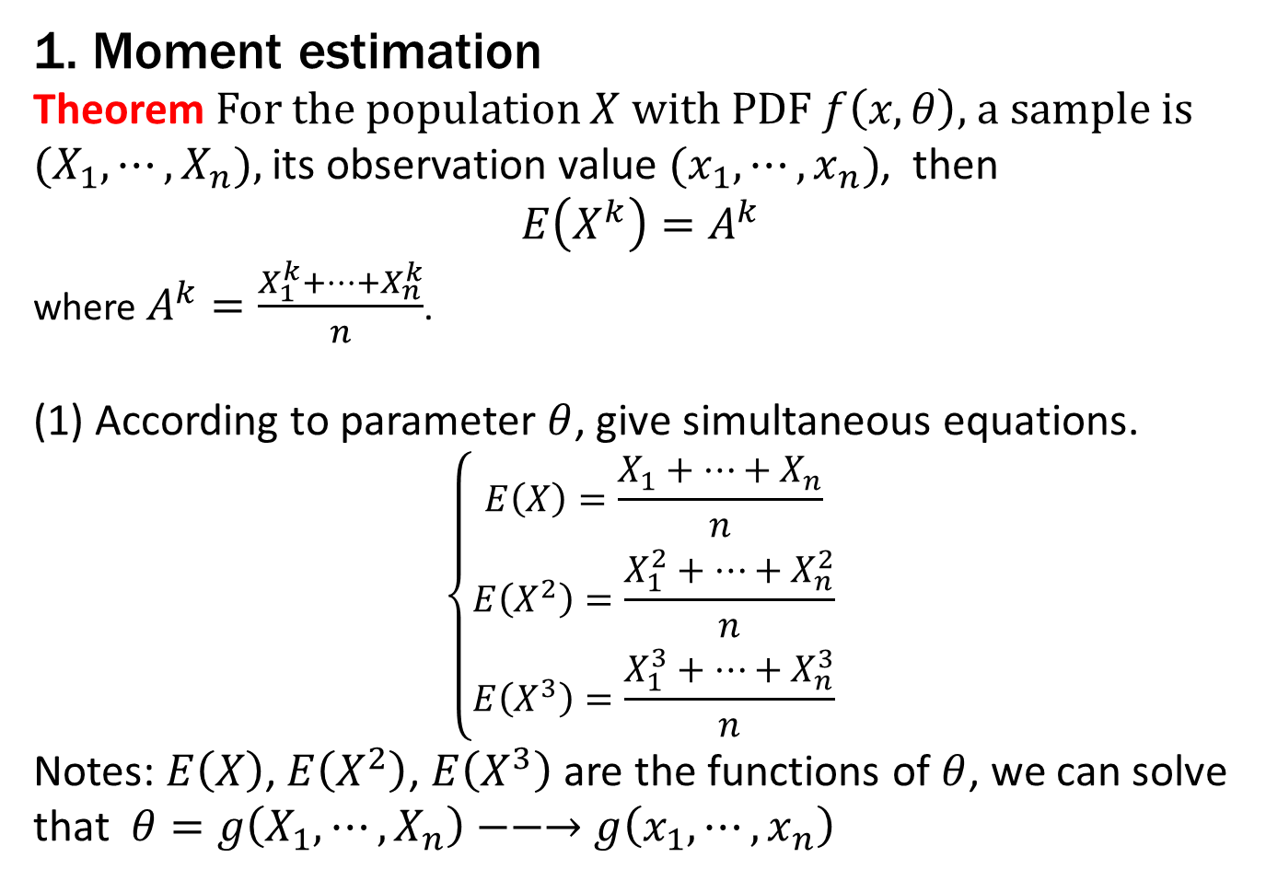
2 Parameter estimation
1. Moment estimation
Theorem For the population $X$ with PDF $f\left(x,θ\right)$, a sample is ${(X}_{1},⋯,X_{n}),$ its observation value ${(x}_{1},⋯,x_{n})$, then
$$E\left(X^{k}\right)=A^{k}$$
where $A^{k}=\frac{X_{1}^{k}+⋯+X_{n}^{k}}{n}$.
(1) According to parameter $θ$, give simultaneous equations.
$$\left\{\begin{matrix}E\left(X\right)=\frac{X_{1}+⋯+X_{n}}{n} \\ E\left(X^{2}\right)=\frac{X_{1}^{2}+⋯+X_{n}^{2}}{n} \\ E\left(X^{3}\right)=\frac{X_{1}^{3}+⋯+X_{n}^{3}}{n}\end{matrix}\right.$$
Notes: $E\left(X\right)$, $E\left(X^{2}\right)$, $E\left(X^{3}\right)$ are the functions of $θ$, we can solve that $θ=g\left(X_{1},⋯,X_{n}\right)−−→$ $g\left(x_{1},⋯,x_{n}\right)$

Slide 8

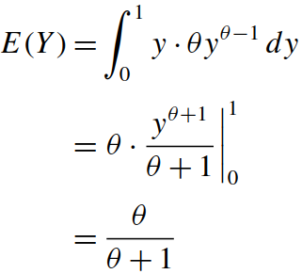



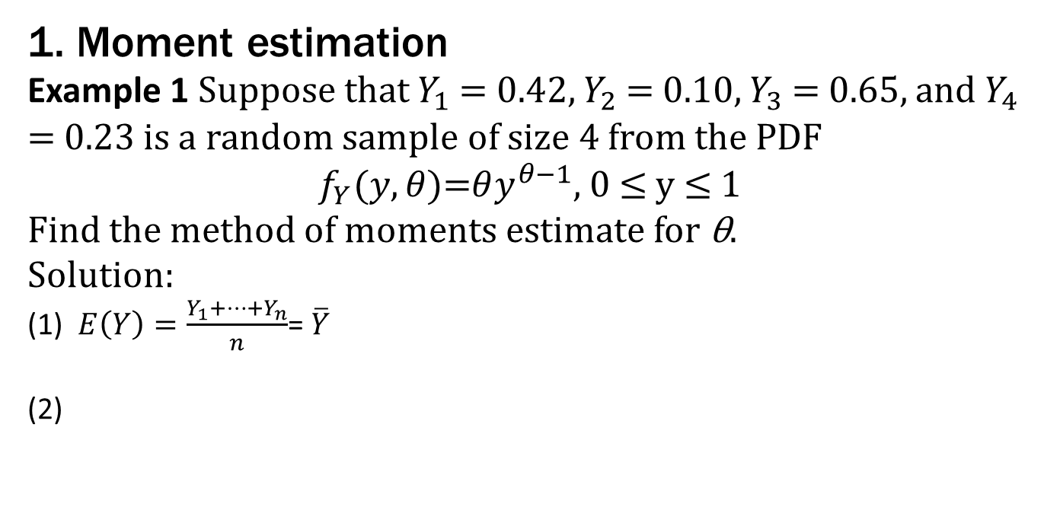
2 Parameter estimation
1. Moment estimation
Example 1 Suppose that $Y_{1}$ = 0.42, $Y_{2}$ = 0.10, $Y_{3}$ = 0.65, and $Y_{4}$ = 0.23 is a random sample of size 4 from the PDF
$f_{Y}(y,θ)$=$θy^{θ−1}$, 0 ≤ y ≤ 1
Find the method of moments estimate for θ.
Solution:
(1) $E\left(Y\right)=\frac{Y_{1}+⋯+Y_{n}}{n}$= $\overline{Y}$
(2)
Estimated value :
Estimated r.v. : $\hat{θ}=\frac{\overline{Y}}{1−\overline{Y}}$

Slide 9
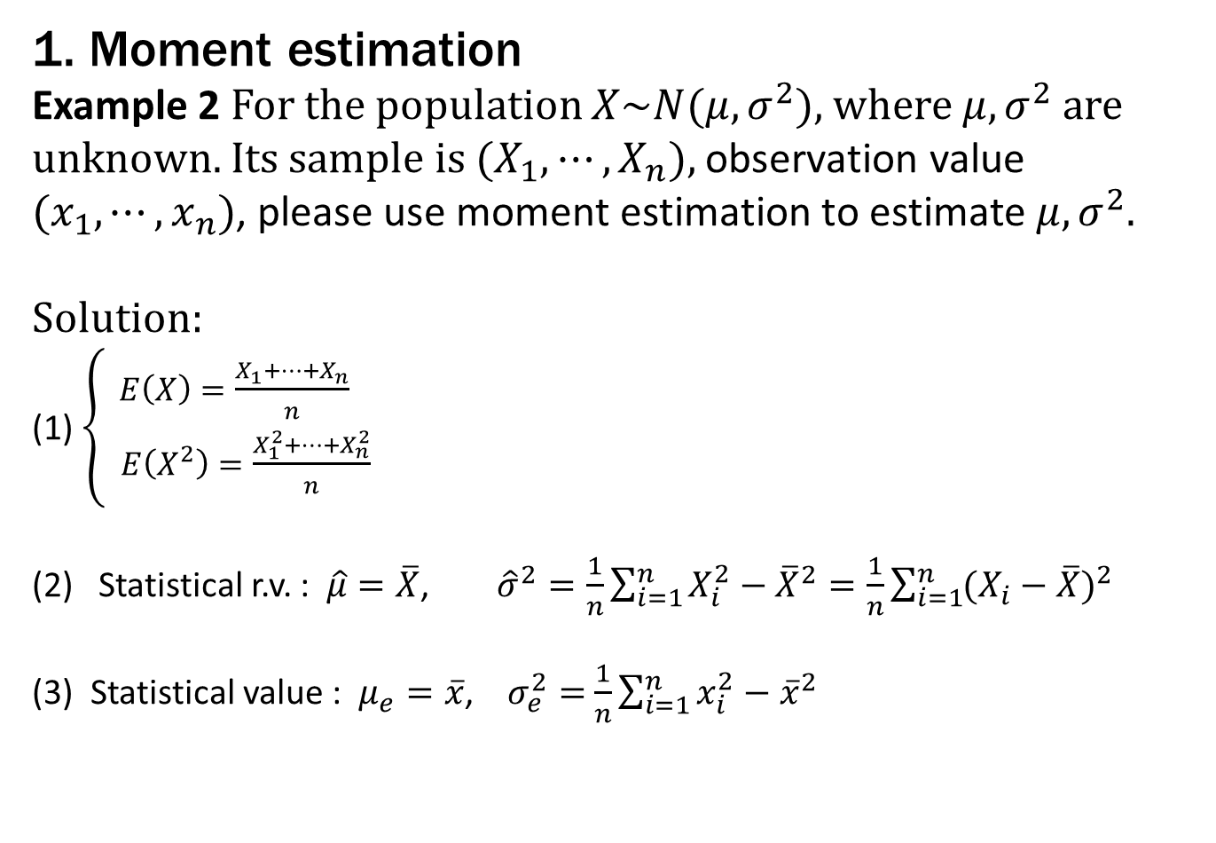
2 Parameter estimation
1. Moment estimation
Example 2 For the population $X\sim N(μ,σ^{2})$, where$μ,σ^{2}$are unknown. Its sample is ${(X}_{1},⋯,X_{n}),$ observation value ${(x}_{1},⋯,x_{n})$, please use moment estimation to estimate $μ,σ^{2}.$
Solution:
(1) $\left\{\begin{aligned}E\left(X\right)=\frac{X_{1}+⋯+X_{n}}{n} \\ E\left(X^{2}\right)=\frac{X_{1}^{2}+⋯+X_{n}^{2}}{n}\end{aligned}\right.$
Statistical r.v. : $\hat{μ}=\overline{X}$, ${\hat{σ}}^{2}=\frac{1}{n}\sum_{i=1}^{n}{X_{i}^{2}}−{\overline{X}}^{2}=\frac{1}{n}\sum_{i=1}^{n}{{(X_{i}−\overline{X})}^{2}}$
(3) Statistical value : $μ_{e}=\overline{x}$, $σ_{e}^{2}=$ $\frac{1}{n}\sum_{i=1}^{n}{x_{i}^{2}}−{\overline{x}}^{2}$

Slide 10
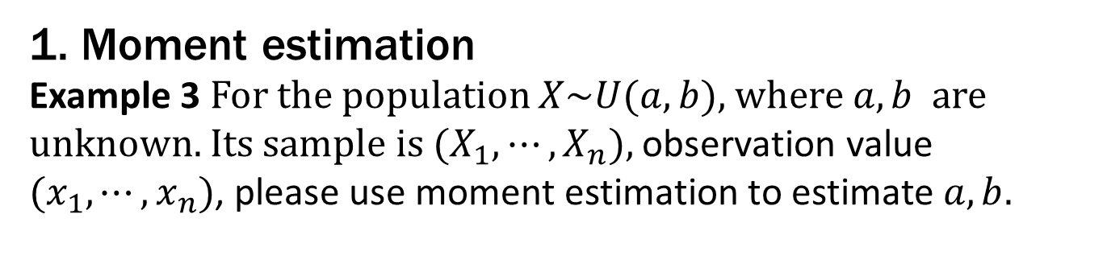
2 Parameter estimation
1. Moment estimation
Example 3 For the population $X\sim U(a,b)$, where$a,b$ are unknown. Its sample is ${(X}_{1},⋯,X_{n}),$ observation value ${(x}_{1},⋯,x_{n})$, please use moment estimation to estimate $a,b.$

Slide 11
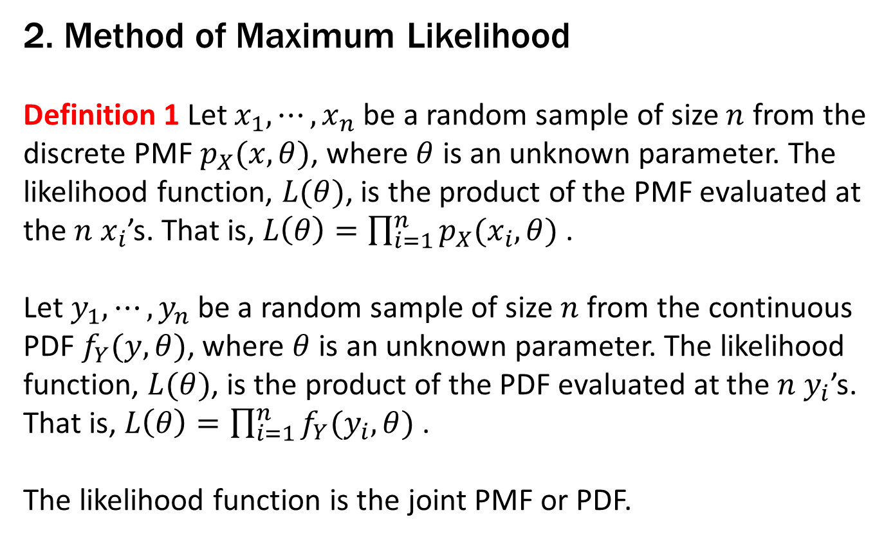
2 Parameter estimation
2. Method of Maximum Likelihood
Definition 1 Let $x_{1},⋯,x_{n}$ be a random sample of size $n$ from the discrete PMF $p_{X}(x,θ)$, where $θ$ is an unknown parameter. The likelihood function, $L(θ)$, is the product of the PMF evaluated at the $n$ $x_{i}$’s. That is, $L\left(θ\right)=\prod_{i=1}^{n}{p_{X}(x_{i},θ)}$ .
Let $y_{1},⋯,y_{n}$ be a random sample of size $n$ from the continuous
PDF $f_{Y}(y,θ)$, where $θ$ is an unknown parameter. The likelihood function, $L(θ)$, is the product of the PDF evaluated at the $n$ $y_{i}$’s. That is, $L\left(θ\right)=\prod_{i=1}^{n}{f_{Y}(y_{i},θ)}$ .
The likelihood function is the joint PMF or PDF.

Slide 12




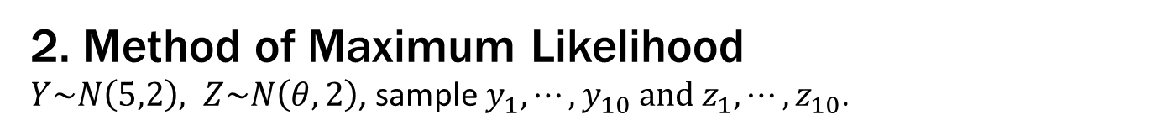





2 Parameter estimation
2. Method of Maximum Likelihood
$Y\sim N\left(5,2\right), Z\sim N\left(θ,2\right)$, sample $y_{1},⋯,y_{10} and$ $z_{1},⋯,z_{10}$.
Elementary:
$$μ=5$$
$$sampling$$
$$f_{Y}(y)$$
$$y_{1},⋯,y_{10}$$
$$θ^{∗}=5$$
$f_{Z}(z_{1},θ)$*…*$f_{Z}(z_{2},θ)$
$$fitting$$
$$f_{Z}(z,θ)$$
$$z_{1},⋯,z_{10}$$

Slide 13
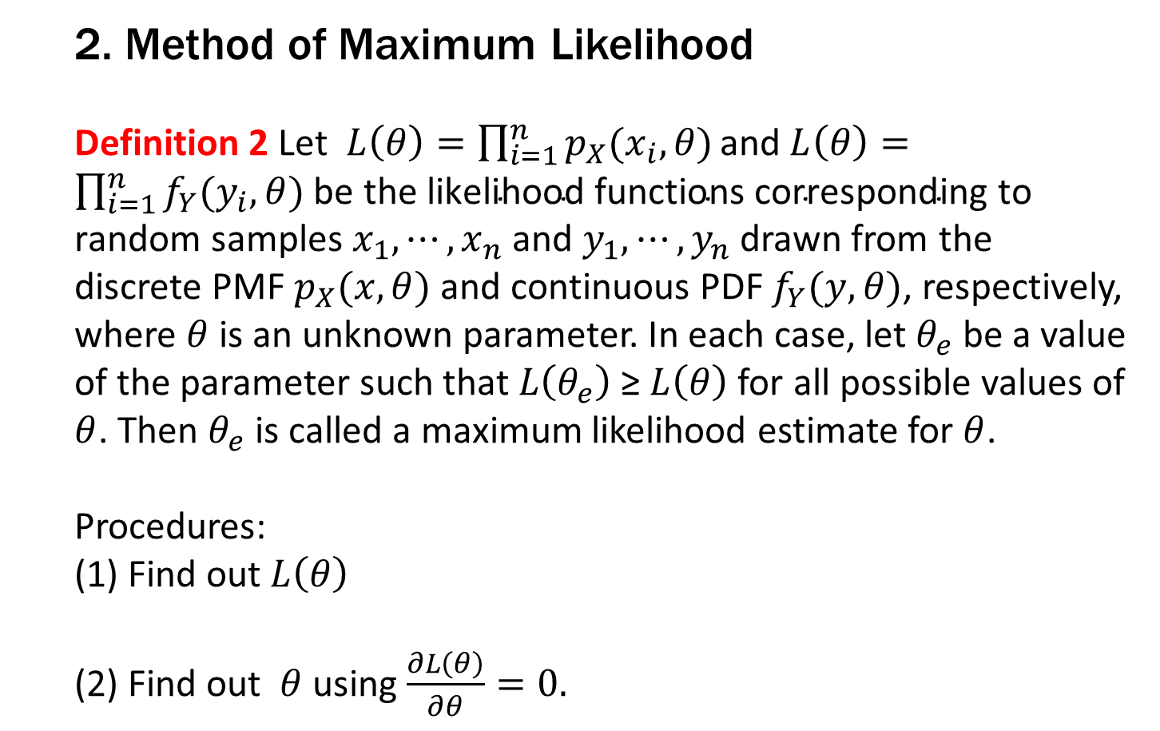
2 Parameter estimation
2. Method of Maximum Likelihood
Definition 2 Let$L\left(θ\right)=\prod_{i=1}^{n}{p_{X}(x_{i},θ)}\text{and} L\left(θ\right)=\prod_{i=1}^{n}{f_{Y}(y_{i},θ)}$ $\text{be} \text{the} \text{likelihood} \text{functions} \text{corresponding} \text{to} \text{random} \text{samples} x_{1},⋯,x_{n}$ and $y_{1},⋯,y_{n}$drawn from the discrete PMF $p_{X}(x,θ)$ and continuous PDF $f_{Y}(y,θ)$, respectively, where $θ$ is an unknown parameter. In each case, let $θ_{e}$ be a value of the parameter such that $L\left(θ_{e}\right)$ ≥ $L\left(θ\right)$ for all possible values of $θ$. Then $θ_{e}$ is called a maximum likelihood estimate for $θ$.
Procedures:
(1) Find out $L\left(θ\right)$
(2) Find out $θ$ using $\frac{∂L\left(θ\right)}{∂θ}=0.$

Slide 14
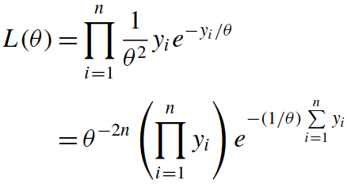
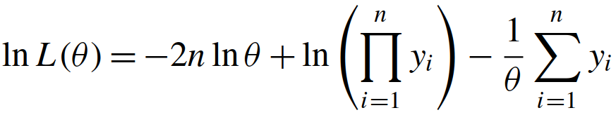
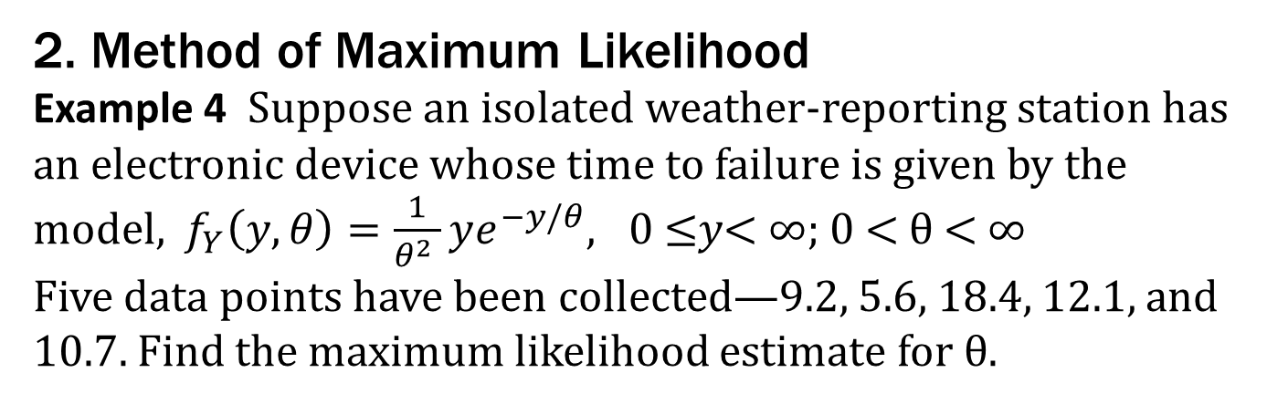
2 Parameter estimation
2. Method of Maximum Likelihood
Example 4 Suppose an isolated weather-reporting station has an electronic device whose time to failure is given by the model, $f_{Y}\left(y,θ\right)=\frac{1}{θ^{2} }ye^{−y/θ}, \text{0 ≤}y\text{< ∞; 0 < }\text{θ}\text{ < ∞}$
Five data points have been collected—9.2, 5.6, 18.4, 12.1, and 10.7. Find the maximum likelihood estimate for θ.
Solution: (1)

Slide 15
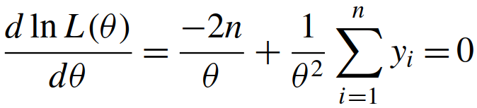
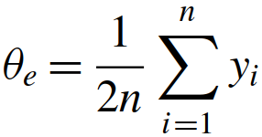
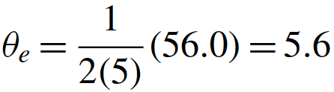
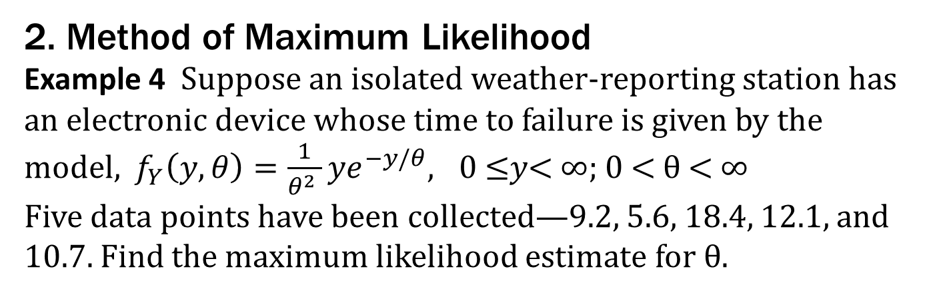
2 Parameter estimation
2. Method of Maximum Likelihood
Example 4 Suppose an isolated weather-reporting station has an electronic device whose time to failure is given by the model, $f_{Y}\left(y,θ\right)=\frac{1}{θ^{2} }{ye}^{−y/θ}, \text{0 ≤}y\text{< ∞; 0 < }\text{θ}\text{ < ∞}$
Five data points have been collected—9.2, 5.6, 18.4, 12.1, and 10.7. Find the maximum likelihood estimate for θ.
Solution: (2)

Slide 16
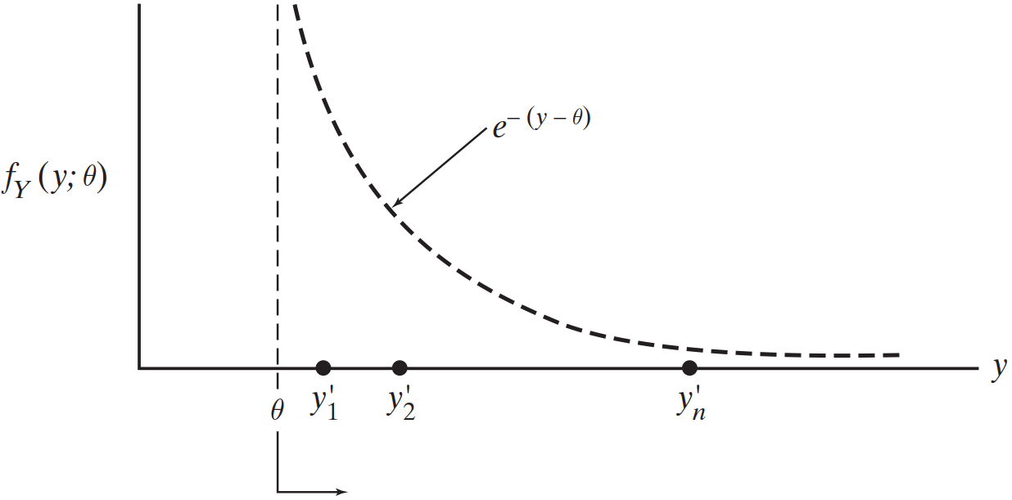
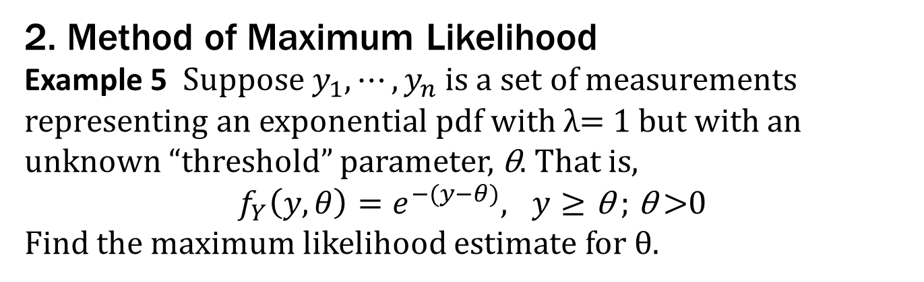
2 Parameter estimation
2. Method of Maximum Likelihood
Example 5 Suppose $y_{1},⋯,y_{n}$is a set of measurements representing an exponential pdf with λ= 1 but with an unknown “threshold” parameter, $\text{θ}$. That is,
$f_{Y}\left(y,θ\right)=e^{−(y−θ)}, y≥\text{θ} \text{; }\text{θ} \text{>0}$
Find the maximum likelihood estimate for θ.

Slide 17
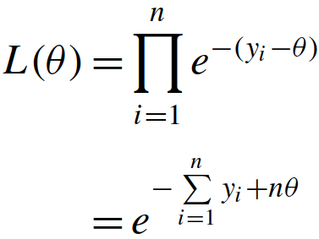
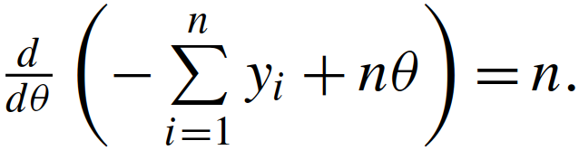


2 Parameter estimation
2. Method of Maximum Likelihood
Example 5
Solution: (1)
(2) (does not work)
(3) Directly analyze the monotonicity of $f_{Y}\left(y,θ\right)$
For any $θ≤y_{i}$ , therefore $\hat{θ}≤Y_{min}$
$θ_{e}=$ $y_{min}$, $y_{min}∈\left\{y_{1},⋯,y_{n}\right\}.$

Slide 18
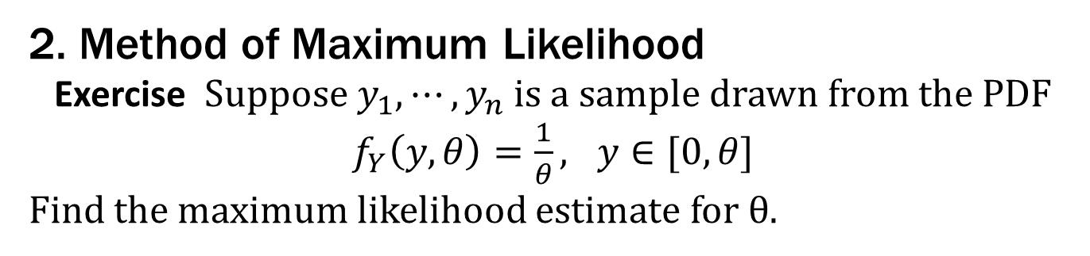
2 Parameter estimation
2. Method of Maximum Likelihood
Exercise Suppose $y_{1},⋯,y_{n}$is a sample drawn from the PDF
$f_{Y}\left(y,θ\right)=\frac{1}{θ}, y∈[0,θ]$
Find the maximum likelihood estimate for θ.

Slide 19
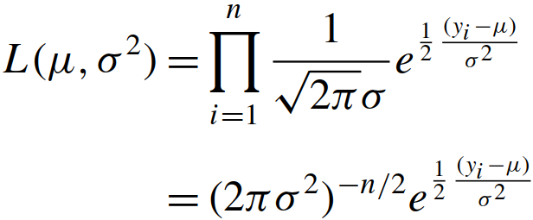
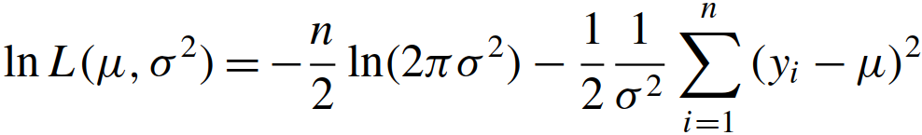
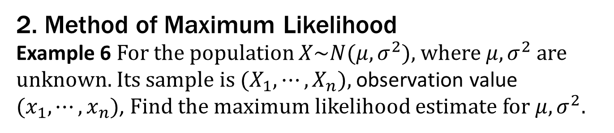
2 Parameter estimation
2. Method of Maximum Likelihood
Example 6 For the population $X\sim N(μ,σ^{2})$, where$μ,σ^{2}$are unknown. Its sample is ${(X}_{1},⋯,X_{n}),$ observation value ${(x}_{1},⋯,x_{n})$, Find the maximum likelihood estimate for $μ,σ^{2}.$
Solution: (1)

Slide 20
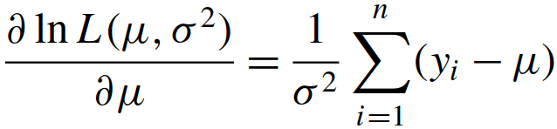
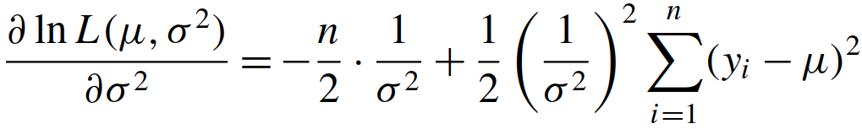
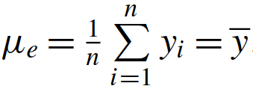
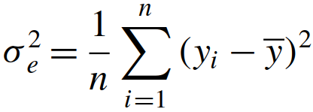
2 Parameter estimation
2. Method of Maximum Likelihood
Example 6 For the population $X\sim N(μ,σ^{2})$, where$μ,σ^{2}$are unknown. Its sample is ${(X}_{1},⋯,X_{n}),$ observation value ${(x}_{1},⋯,x_{n})$, Find the maximum likelihood estimate for $μ,σ^{2}.$
Solution: (2)

Slide 21
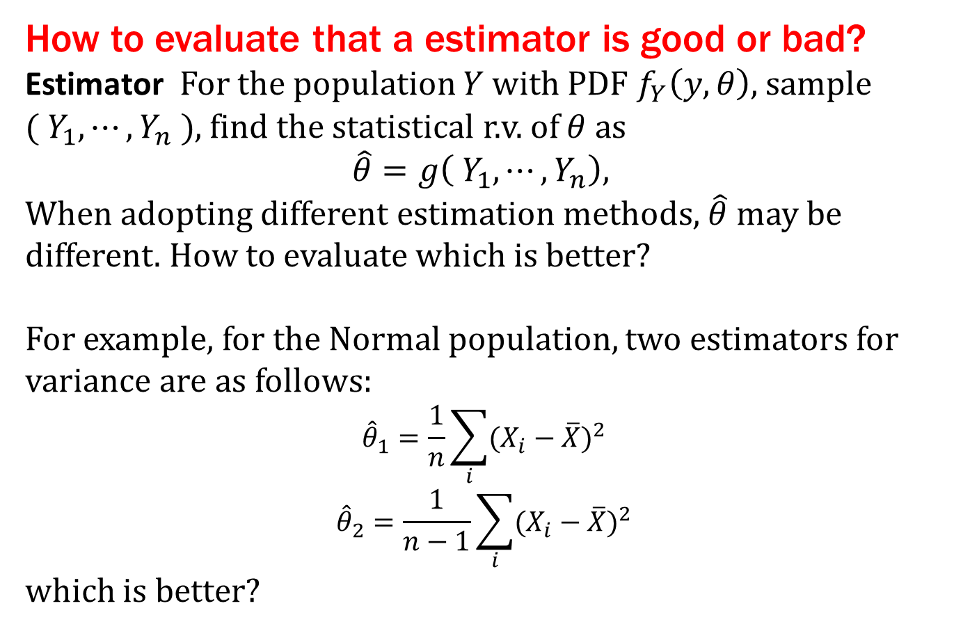
3 Properties of parameter estimators
How to evaluate that a estimator is good or bad?
Estimator For the population $Y$ with PDF $f_{Y}\left(y, θ\right)$, sample ${( Y}_{1},⋯,Y_{n} )$, find the statistical r.v. of $θ$ as
$$\hat{θ}=g\left({ Y}_{1},⋯,Y_{n}\right),$$
When adopting different estimation methods, $\hat{θ}$ may be different. How to evaluate which is better?
For example, for the Normal population, two estimators for variance are as follows:
$${\hat{θ}}_{1}=\frac{1}{n}\sum_{i}{{(X_{i}−\overline{X})}^{2}}$$
$${\hat{θ}}_{2}=\frac{1}{n−1}\sum_{i}{{(X_{i}−\overline{X})}^{2}}$$
which is better?

Slide 22
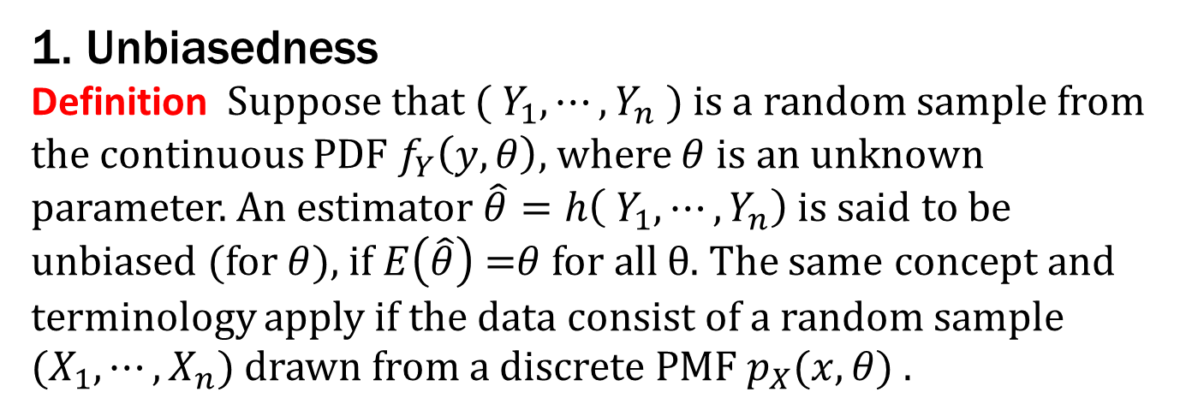
3 Properties of parameter estimators
1. Unbiasedness
Definition Suppose that ${( Y}_{1},⋯,Y_{n} )$ is a random sample from the continuous PDF $f_{Y}\left(y, θ\right)$, where $θ$ is an unknown parameter. An estimator $\hat{θ}=h\left({ Y}_{1},⋯,Y_{n}\right)$ is said to be unbiased (for $θ$), if $E\left(\hat{θ}\right)$ =$θ$ for all θ. The same concept and terminology apply if the data consist of a random sample
${(X}_{1},⋯,X_{n})$ drawn from a discrete PMF $p_{X}(x,θ)$ .

Slide 23
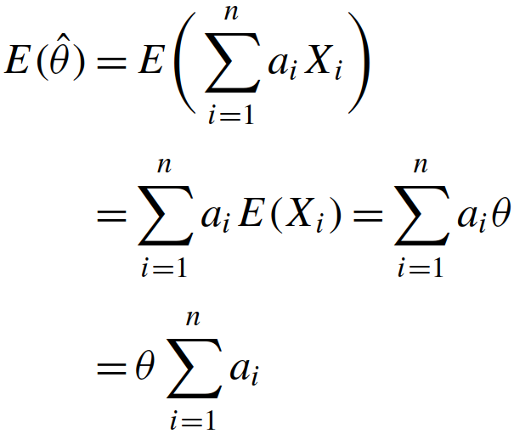
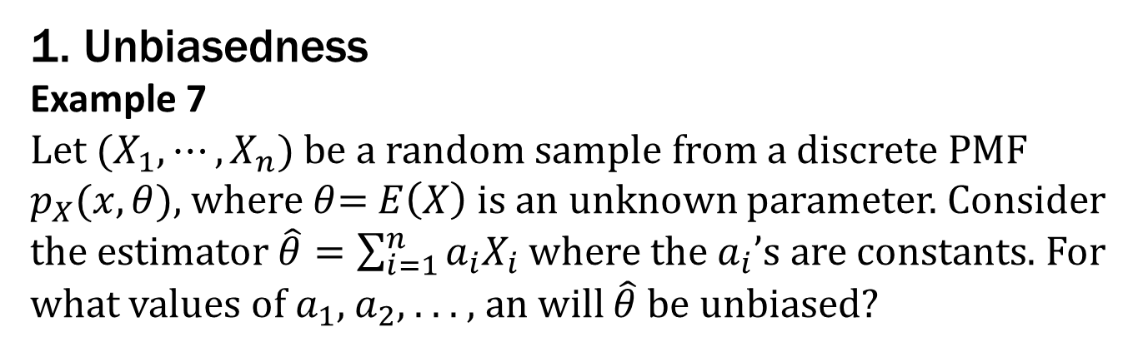
3 Properties of parameter estimators
1. Unbiasedness
Example 7
Let $(X_{1},⋯,X_{n})$ be a random sample from a discrete PMF $p_{X}(x,θ)$, where $θ$= $E\left(X\right)$is an unknown parameter. Consider the estimator $\hat{θ}=\sum_{i=1}^{n}{a_{i}X_{i}}$ where the $a_{i}$’s are constants. For what values of $a_{1}$, $a_{2}$, . . . , an will $\hat{θ}$be unbiased?

Slide 24
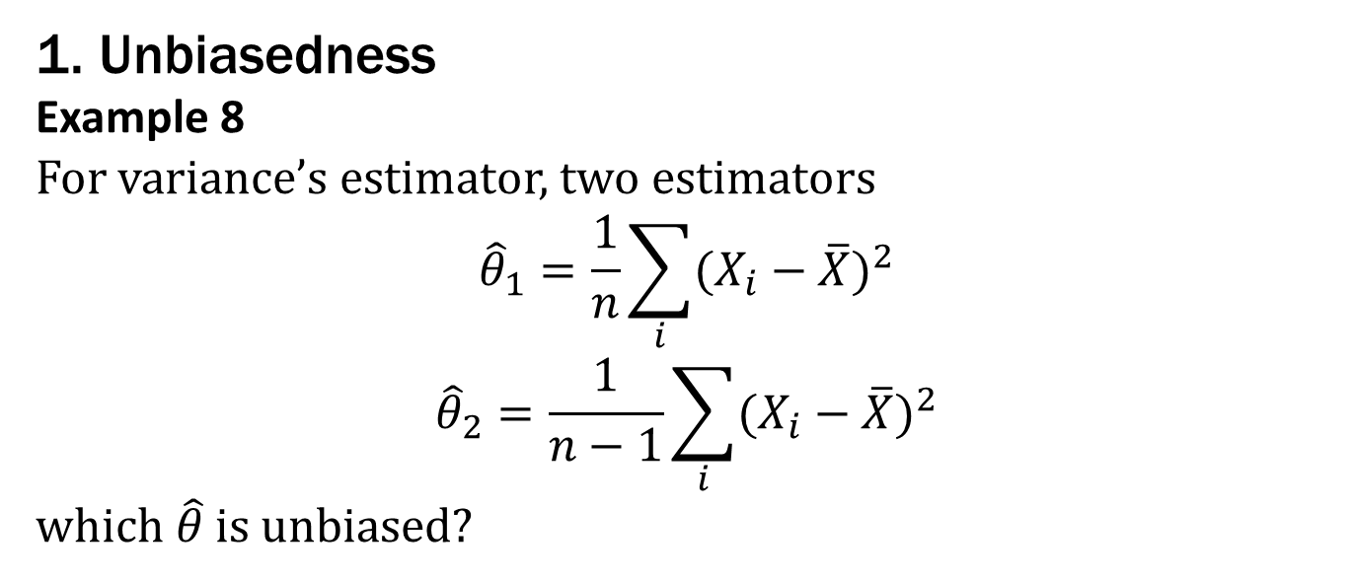
3 Properties of parameter estimators
1. Unbiasedness
Example 8
For variance’s estimator, two estimators
$${\hat{θ}}_{1}=\frac{1}{n}\sum_{i}{{(X_{i}−\overline{X})}^{2}}$$
$${\hat{θ}}_{2}=\frac{1}{n−1}\sum_{i}{{(X_{i}−\overline{X})}^{2}}$$
w$hich \hat{θ}$is unbiased?

Slide 25
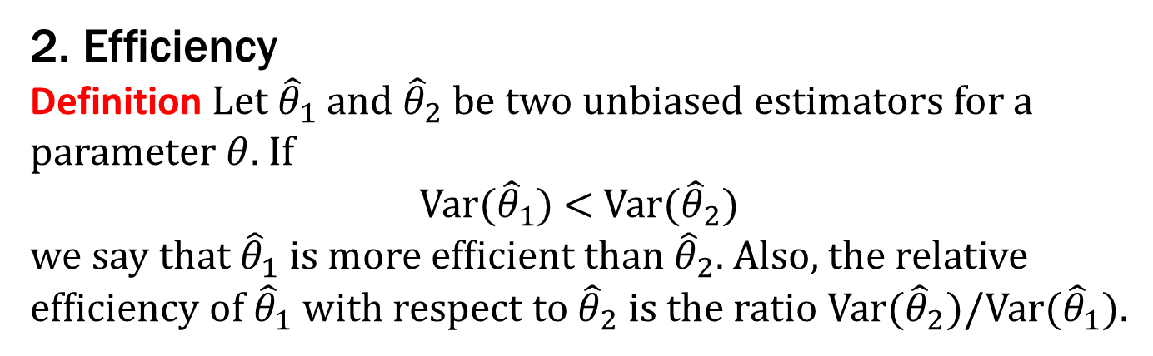
3 Properties of parameter estimators
2. Efﬁciency
Definition Let ${\hat{θ}}_{1}$ and ${\hat{θ}}_{2}$be two unbiased estimators for a parameter $θ$. If
Var(${\hat{θ}}_{1}$) < Var(${\hat{θ}}_{2}$)
we say that ${\hat{θ}}_{1}$ is more efﬁcient than ${\hat{θ}}_{2}$. Also, the relative efﬁciency of ${\hat{θ}}_{1}$ with respect to ${\hat{θ}}_{2}$ is the ratio Var(${\hat{θ}}_{2}$)/Var(${\hat{θ}}_{1}$).

Slide 26
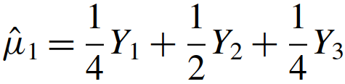
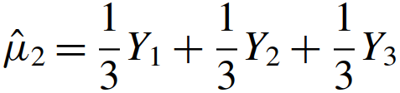
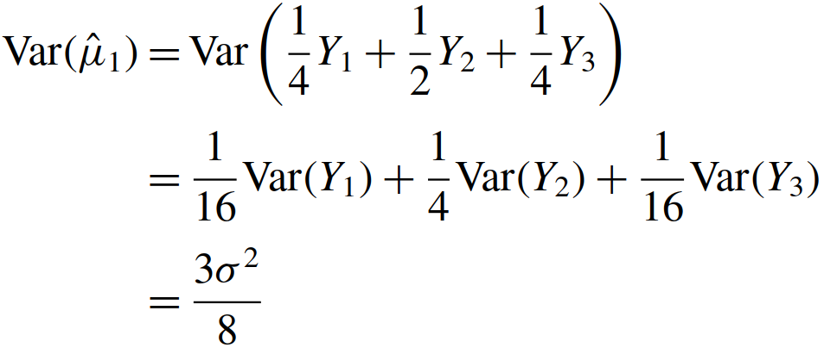
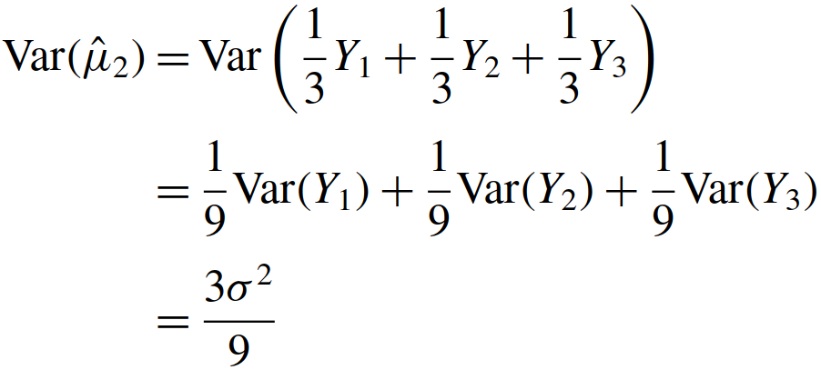
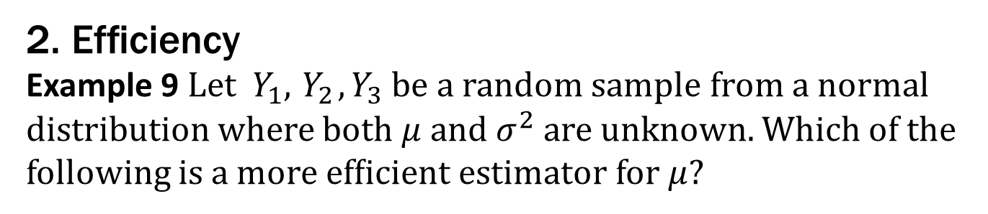
3 Properties of parameter estimators
2. Efﬁciency
Example 9 Let ${ Y}_{1},{ Y}_{2},Y_{3}$ be a random sample from a normal distribution where both $μ$and $σ^{2}$ are unknown. Which of the following is a more efﬁcient estimator for $μ$?

Slide 27
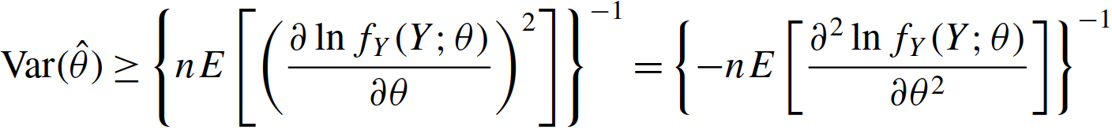

3 Properties of parameter estimators
2. Efﬁciency
Theorem (Cramér-Rao Inequality)
Theorem (minimum-variance ${\hat{θ}}^{∗}$)

Slide 28

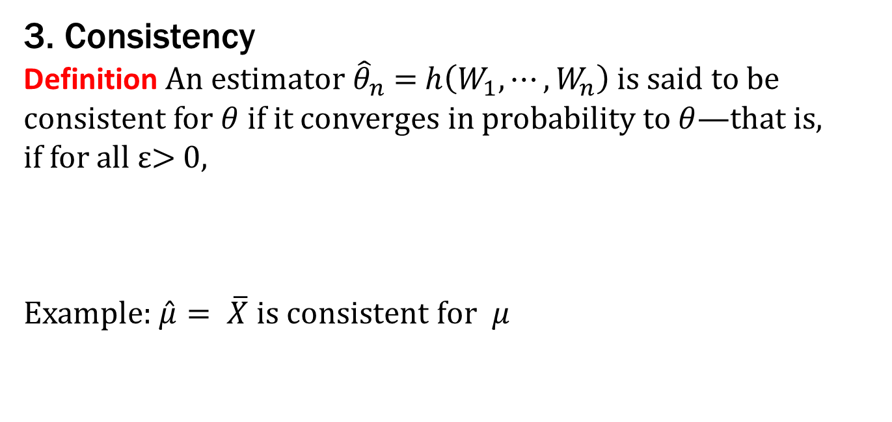
3 Properties of parameter estimators
3. Consistency
Definition An estimator ${\hat{θ}}_{n}$ = $h\left(W_{1},⋯,W_{n}\right)$is said to be consistent for $θ$ if it converges in probability to $θ$—that is,
if for all ε> 0,
Example:$\hat{μ}= \overline{X} \text{is} \text{consistent} \text{for} μ$

Slide 29
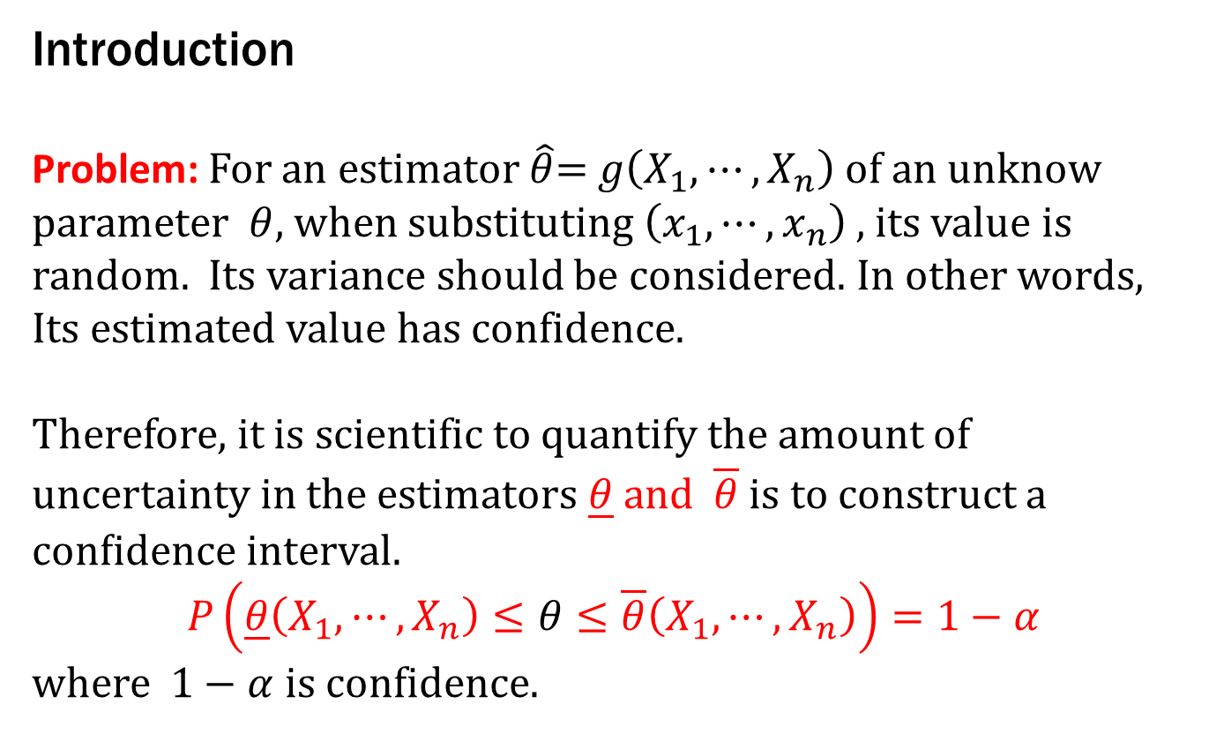
4 Interval Estimation
Introduction
Problem: For an estimator $\hat{θ}$= $g\left(X_{1},⋯,X_{n}\right)$of an unknow parameter $θ$, when substituting $\left(x_{1},⋯,x_{n}\right)$, its value is random. Its variance should be considered. In other words,
Its estimated value has confidence.
Therefore, it is scientific to quantify the amount of uncertainty in the estimators $\underline{θ} and \overline{θ}$ is to construct a conﬁdence interval.
$$P\left(\underline{θ}\left(X_{1},⋯,X_{n}\right)≤θ≤\overline{θ}\left(X_{1},⋯,X_{n}\right)\right)=1−α$$
where $1−α$ is confidence.

Slide 30
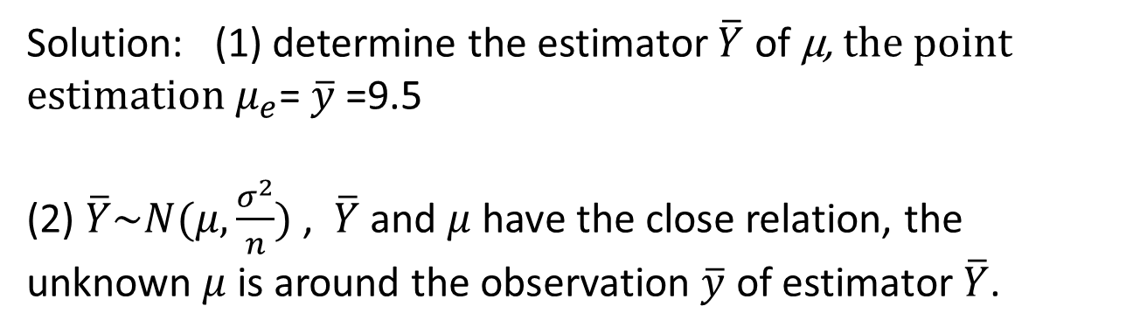
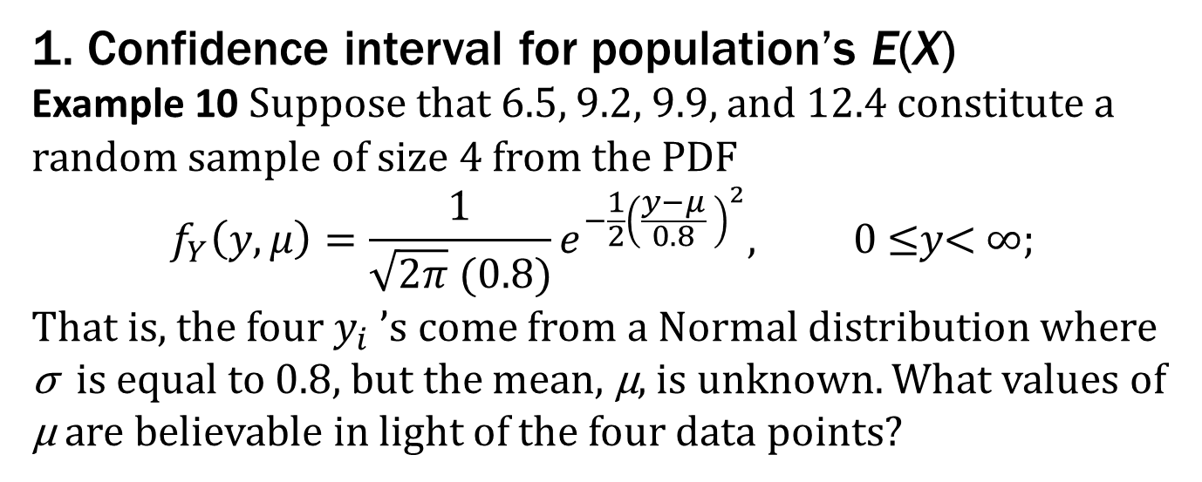
4 Interval Estimation
1. Confidence interval for population’s E(X)
Example 10 Suppose that 6.5, 9.2, 9.9, and 12.4 constitute a random sample of size 4 from the PDF
$$f_{Y}\left(y,μ\right)=\frac{1}{\sqrt{2π} (0.8)}e^{−\frac{1}{2}{\left(\frac{y−μ}{0.8} \right)}^{2}}, \text{0 ≤}y\text{< ∞; }$$
That is, the four $y_{i}$ ’s come from a Normal distribution where σ is equal to 0.8, but the mean, µ, is unknown. What values of µ are believable in light of the four data points?
Solution: (1) determine the estimator $\overline{Y}$ of µ, the point estimation $μ_{e}$= $\overline{y}$ =9.5
(2) $\overline{Y}\sim N(μ,\frac{σ^{2}}{n})$ , $\overline{Y}$ and $μ$ have the close relation, the unknown $μ$is around the observation $\overline{y}$ of estimator $\overline{Y}$.

Slide 31

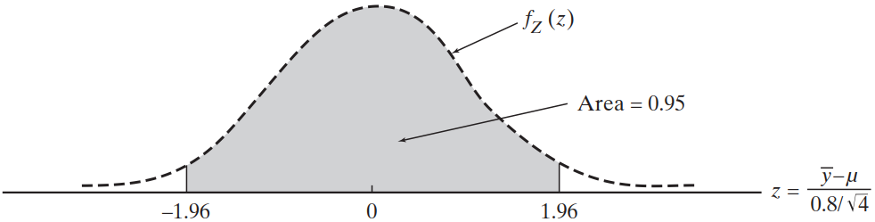


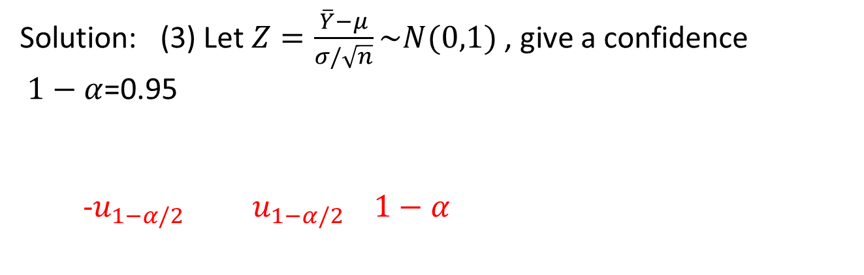


4 Interval Estimation
1. Confidence interval for population’s E(X)
Example 10
Solution: (3) Let$Z=\frac{\overline{Y}−μ}{σ/\sqrt{n}}\sim N(0,1)$ , give a confidence
$1−α$=0.95
-$u_{1−α/2}$ $u_{1−α/2} 1−α$
$$0.025$$
$$0.025$$
$${−u}_{0.975}$$
$$u_{0.975}$$

Slide 32


Slide 33




4 Interval Estimation
1. Confidence interval for population’s E(X)
Example 10
Solution: (4) Let$Z=\frac{\overline{Y}−μ}{σ/\sqrt{n}}\sim N(0,1)$ , give a confidence$α$=0.95

Slide 34

4 Interval Estimation
1. Confidence interval for population’s E(X)
Definition and Concept about confidence interval
Population: $X$ with PDF $f\left(x,θ\right)$
Sample: ${(X}_{1},⋯,X_{n})$ with observation ${(x}_{1},⋯,x_{n})$
Statistical r.v.s: $\underline{θ}\left(X_{1},⋯,X_{n}\right), \overline{θ}\left(X_{1},⋯,X_{n}\right)$
Random interval: $[ \underline{θ}\left(X_{1},⋯,X_{n}\right), \overline{θ}\left(X_{1},⋯,X_{n}\right) ]$
Confidence lower limit: $\underline{θ}\left(X_{1},⋯,X_{n}\right)$
Confidence upper limit: $\overline{θ}\left(X_{1},⋯,X_{n}\right)$
Confidence level:$1−α$, classical$α$ values {0.10, 0.05,0.01}

Slide 35

4 Interval Estimation
1. Confidence interval for population’s E(X)
Definition and Concept about confidence interval
Two-tailed confidence interval:
$$P\left(\underline{θ}\left(X_{1},⋯,X_{n}\right)≤θ≤\overline{θ}\left(X_{1},⋯,X_{n}\right)\right)=1−α$$
One-tailed confidence interval:
$$P\left(\underline{θ}\left(X_{1},⋯,X_{n}\right)≤θ\right)=1−α$$
$$P\left(θ≤\overline{θ}\left(X_{1},⋯,X_{n}\right)\right)=1−α$$
Explain: In the probability (confidence level) $1−α$, the unknown parameter$θ$ falls in the random intervals,
[$\underline{θ}\left(X_{1},⋯,X_{n}\right)$, $\overline{θ}\left(X_{1},⋯,X_{n}\right)$], [$\underline{θ}\left(X_{1},⋯,X_{n}\right)$,$∞$],
[- $∞$, $\overline{θ}\left(X_{1},⋯,X_{n}\right)$]

Slide 36






4 Interval Estimation
1. Confidence interval for population’s E(X)
General form for$μ$ ($σ^{2}$ is known) for Normal population
Let$Y$ with $E\left(Y\right)=μ, Var\left(Y\right)=σ^{2}$, $μ$ is unknown, $σ^{2}$ is known.
$\overline{Y}$ is estimator for $μ$. Let $Z=\frac{\overline{Y}−μ}{σ/\sqrt{n}}\sim N(0,1)$. The ($1−α$) confidence interval for $μ$,
$$\left(\overline{y}−z_{1−\frac{α}{2}}∙\frac{σ}{\sqrt{n}},\overline{y}+z_{1−\frac{α}{2}}∙\frac{σ}{\sqrt{n}}\right)$$
$P\left(Z≤z_{1−\frac{α}{2}}\right)=$ 1-$\frac{α}{2}$
$$1−α$$
$$−z_{1−α/2}$$
$$z_{1−α/2}$$

Slide 37





4 Interval Estimation
1. Confidence interval for population’s E(X)
General form for$μ$ ($σ^{2}$ is unknown) for Normal population
Let$Y$ with $E\left(Y\right)=μ, Var\left(Y\right)=σ^{2}$, $μ$ and $σ^{2}$ are unknown.
$\overline{Y}$ is estimator for $μ$. Let $T=\frac{\sqrt{n}(\overline{Y}−μ)}{S}\sim T(n−1)$. The ($1−α$) confidence interval for $μ$,
$$\left(\overline{y}−t_{1−\frac{α}{2}}∙\frac{s}{\sqrt{n}},\overline{y}+t_{1−\frac{α}{2}}∙\frac{s}{\sqrt{n}}\right)$$
$$f_{T}(t)$$
$$1−α$$
$$−t_{1−α/2}$$
$$t_{1−α/2}$$

Slide 38


Slide 39


4 Interval Estimation
1. Confidence interval for population’s E(X)
Margin of Error for$μ$ for Normal population
Case 1: $σ^{2}$ are known.
Margin of Error: $M={2∙z}_{1−\frac{α}{2}}∙\frac{σ}{\sqrt{n}}$
Case 2: $σ^{2}$ are unknown.
Margin of Error: $M={2∙t}_{1−\frac{α}{2}}∙\frac{s}{\sqrt{n}}$
Notes:
Keep sample size $n$ unchanged, if $(1−α) ↗$ , $then M↗,$
estimate accuracy (M’s value increases) $↘$.
(2) Keep $(1−α)$unchanged, if sample size $n↗$ , $then M↘,$
estimate accuracy (M’s value decreases)$↗$.

Slide 40


4 Interval Estimation
2. Confidence interval for population’s Var(X)
General form for $σ^{2}$ ($μ$ is known) for Normal population
Let$Y$ with $E\left(Y\right)=μ, Var\left(Y\right)=σ^{2}$,$μ$ is known. Let estimator ${\hat{σ}}^{2}=\frac{1}{n}\sum_{i=1}^{n}{{(Y_{i}−μ)}^{2}}, \sum_{i=1}^{n}{\frac{{(Y_{i}−μ)}^{2}}{σ^{2}}}\sim χ^{2}(n)$. The ($1−α$) confidence interval for $σ^{2}$,
$P\left(a≤\frac{{n\hat{σ}}^{2}}{σ^{2}}≤b\right)=$ $1−α$
Let $a$= ${χ^{2}}_{\frac{α}{2}}(n)$, $b$= ${χ^{2}}_{1−\frac{α}{2}}(n)$,
$\left[\frac{n{\hat{σ}}^{2}}{{χ^{2}}_{1−\frac{α}{2}}(n)},\frac{n{\hat{σ}}^{2}}{{χ^{2}}_{\frac{α}{2}}(n)}\right]$
Notes: there are many pairs of a, b; ${\hat{σ}}^{2}$ can be estimated by sample observation.

Slide 41


4 Interval Estimation
2. Confidence interval for population’s Var(X)
General form for $σ^{2}$ ($μ$ is unknown) for Normal population
Let$Y$ with $E\left(Y\right)=μ, Var\left(Y\right)=σ^{2}$,$μ$ is unknown.
$S^{2}$ is estimator for${ σ}^{2}$. Let estimator $\frac{(n−1)S^{2}}{σ^{2}}\sim χ^{2}(n−1)$. The ($1−α$) confidence interval for $σ^{2}$,
$P\left(a≤\frac{(n−1)S^{2}}{σ^{2}}≤b\right)=$ $1−α$
Let $a$= ${χ^{2}}_{\frac{α}{2}}(n−1)$, $b$= ${χ^{2}}_{1−\frac{α}{2}}(n−1)$,
$\left[\frac{(n−1)S^{2}}{{χ^{2}}_{1−\frac{α}{2}}(n−1)},\frac{(n−1)S^{2}}{{χ^{2}}_{\frac{α}{2}}(n−1)}\right]$
Notes: $S^{2}$ can be estimated by sample observation.

Slide 42


4 Interval Estimation
3. Confidence interval for two Normal populations
Confidence interval for mean difference $μ_{X}−μ_{Y}$
Two Normal populations: $X\sim N(μ_{X},σ_{X}^{2})$ and $Y\sim N(μ_{Y},σ_{Y}^{2})$
Samples: $(X_{1},⋯,X_{m})$ and $(Y_{1},⋯,Y_{n})$
IF $σ_{X}^{2}$ and $σ_{Y}^{2}$ are known, then
$$\overline{X}−\overline{Y}\sim N(μ_{X}−μ_{Y}, \frac{σ_{X}^{2}}{m}+\frac{σ_{Y}^{2}}{n})$$
$\overline{X}−\overline{Y}$is estimator for $μ_{X}−μ_{Y}$.
Let $Z=\frac{\overline{X}−\overline{Y}−(μ_{X}−μ_{Y})}{\sqrt{\frac{σ_{X}^{2}}{m}+\frac{σ_{Y}^{2}}{n}}}$, then $Z\sim N(0,1)$, the ($1−α$) confidence interval for $μ_{X}−μ_{Y}:$
$$\left[\overline{X}−\overline{Y}−z_{1−\frac{α}{2}}\sqrt{\frac{σ_{X}^{2}}{m}+\frac{σ_{Y}^{2}}{n}}, \overline{X}−\overline{Y}+z_{1−\frac{α}{2}}\sqrt{\frac{σ_{X}^{2}}{m}+\frac{σ_{Y}^{2}}{n}}\right]$$

Slide 43

4 Interval Estimation
3. Confidence interval for two Normal populations
Confidence interval for mean difference $μ_{X}−μ_{Y}$
Two Normal populations: $X\sim N(μ_{X},σ_{X}^{2})$ and $Y\sim N(μ_{Y},σ_{Y}^{2})$
Samples: $(X_{1},⋯,X_{m})$ and $(Y_{1},⋯,Y_{n})$
IF $σ_{X}^{2}=σ_{Y}^{2}$= $σ^{2}$ are unknown, then let $T=\frac{\overline{X}−\overline{Y}−(μ_{X}−μ_{Y})}{S_{w}^{2}\sqrt{\frac{1}{m}+\frac{1}{n}}}$,
$T\sim t(m+n−2)$,
$S_{w}^{2}=\frac{\left(m−1\right)S_{X}^{2}+(n−1)S_{Y}^{2}}{m+n−2}$, the ($1−α$) confidence interval for $μ_{X}−μ_{Y}:$
$$\left[\overline{ X}−\overline{Y}−{k S}_{w} \sqrt{\frac{1}{m}+\frac{1}{n}}, \overline{X}−\overline{Y}+k S_{w} \sqrt{\frac{1}{m}+\frac{1}{n}} \right]$$
Here $k=t_{1−α/2}(m+n−2)$

Slide 44

4 Interval Estimation
3. Confidence interval for two Normal populations
Confidence interval for mean difference $μ_{X}−μ_{Y}$
Example: two machines A and B producing piecework,
Machine A: drawing 9 piecework, $\overline{x}=2.0648,s_{x}^{2}=0.245$
Machine B: drawing 6 piecework, $\overline{y}=2.0594,s_{y}^{2}=0.357$
Evaluate the ($1−α$)=0.95 confidence level of confidence interval for the mean difference $μ_{X}−μ_{Y}$.

